Slide 1

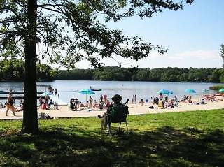
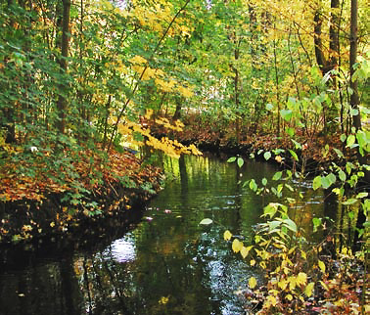
Installing Rain Gardens with Native Plants for Healthy Waters
Ed Himlan and Joel Betts
Worcester County Conservation District
Massachusetts Watershed Coalition
Rain Garden and Seedling Sale Poll

Slide 2
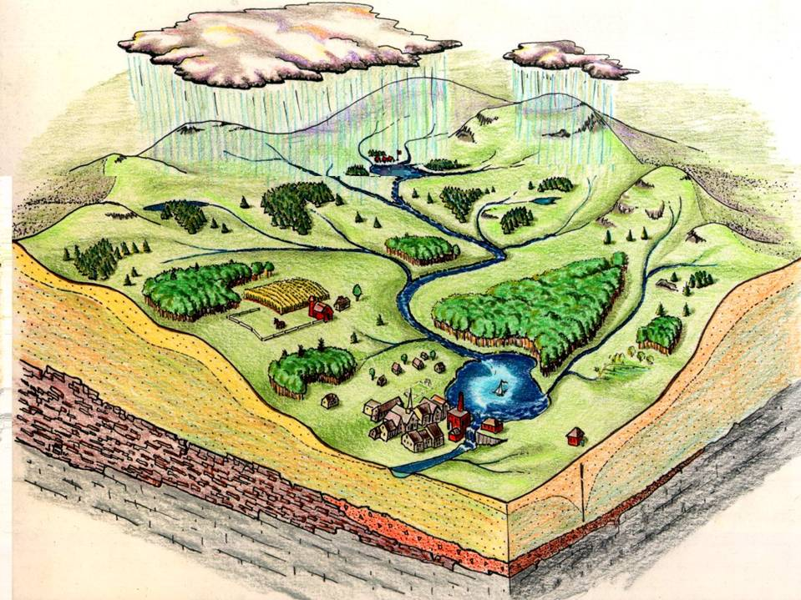
Notes:
What is a watershed?

Slide 3
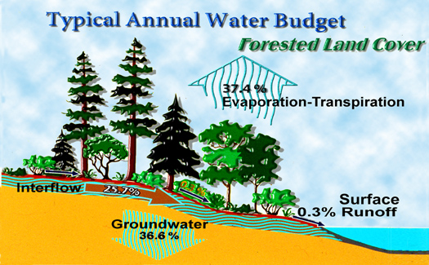
Natural Conditions
Notes:
Water cycle before development. Notice the amount going to groundwater. This is what creates the baseflow that keeps streams running through the summer months.

Slide 4
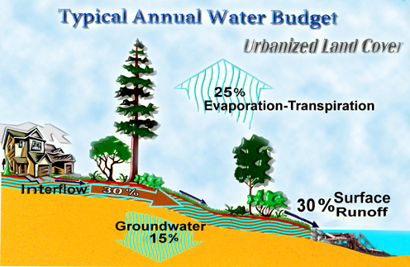
Developed Conditions
Notes:
Water cycle after development. In areas with impervious surface above 10%, water quality and stream health is compromised. Notice the drop in the amount of groundwater infiltration. Dry streambeds in the summer are a result of reduced groundwater baseflow. Streams also get flashier flows which causes erosion and sedimentation in the stream bed.

Slide 5
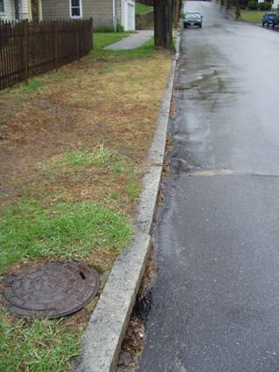
What Happens During Storms
Roofs and driveways drain to catch basins in streets. Storm drain pipes discharge pollutants that harm aquatic life, damage water supplies, increase flooding, and spoil community uses of streams and lakes
Notes:
When the roof runoff drains into the driveway; the driveway drains to the street; the lawn has been planted over compacted soils and the lawn drains to the street; the street has a very well designed Planning Board approved drainage system that quickly removes the water, there will be a huge increase in the volume, frequency and rate of storm water runoff, and the water quality and ground water levels will suffer.

Slide 6

Notes:
When you wash your car in the driveway, you aren’t just washing your car in the driveway...

Slide 7
Pollutants Found in Storm Runoff
Sediment
  Soil particles transported from their source
Biochemical Oxygen Demand (BOD)
● Oxygen depleting material
  Leaves
  Organic material
Toxics
  ● Pesticides
    Herbicides
    Fungicides
    Insecticides
  ● Metals (naturally occurring in soil, automotive emissions/ tires)
    Lead
    Zinc
    Mercury
  ● Petroleum Hydrocarbons (automotive exhaust and fuel/oil)
Nutrients
  ● Various types of materials that become dissolved and suspended in water (commonly found in fertilizer and plant material):
    Nitrogen (N)
    Phosphorus (P)
Bacteria/ Pathogens
Originating from:
  ● Pets
  ● Waterfowl
  ● Failing septic systems
Thermal Stress
  Heated runoff, removal of streamside vegetation
Debris
  Litter and illegal dumping

Slide 8


Slide 10
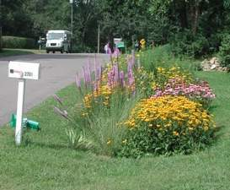
Solutions
Tree conservation • Rain gardens
Narrower streets • Open drainage
On-lot storage and infiltration of water

Slide 11
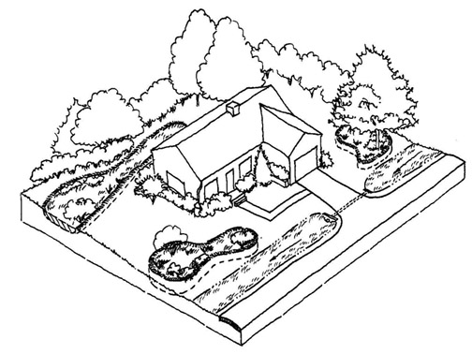
Plant trees & shrubs
Put rain in the ground, where it belongs
Porous Paving
Groundcover
Rain Gardens
Rain Barrel
Creating a Hydrologically Functional Lot
Notes:
These practices can be integrated into every part of site design to create a hydrologically functional lot. Trees and native vegetation provide nature’s storage of rainfall. Permeable pavement, grass swales along roads, rain gardens and amended soils store, filter and infiltrate runoff. Adding rain barrels and other cisterns provide additional water storage.

Slide 12
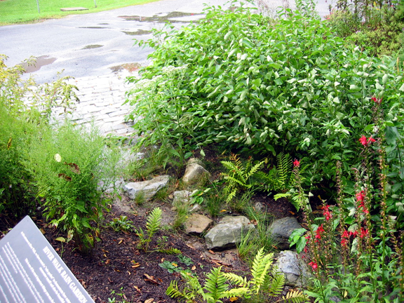
Rain Gardens
Reconnecting with the Rain
Rachel Calabro
Massachusetts Riverways Program

Slide 13
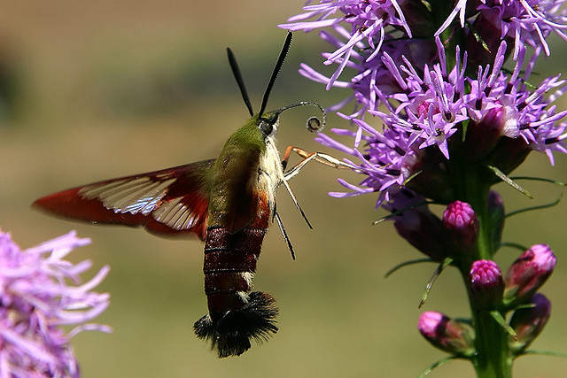
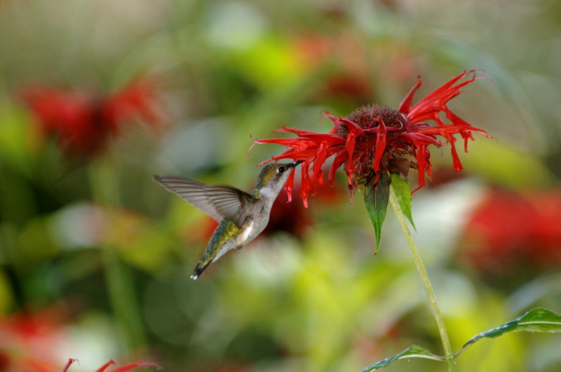
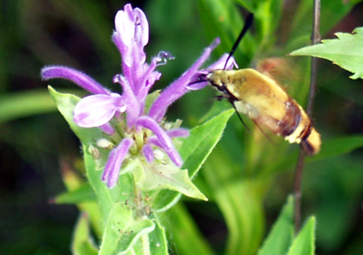
Nectar Attractors

Slide 14
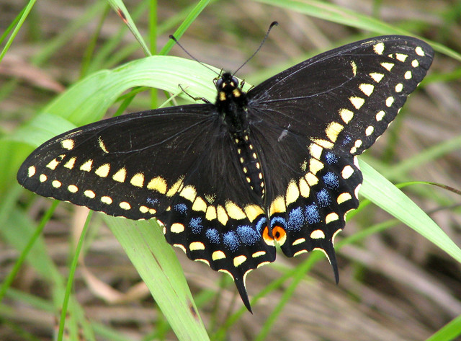
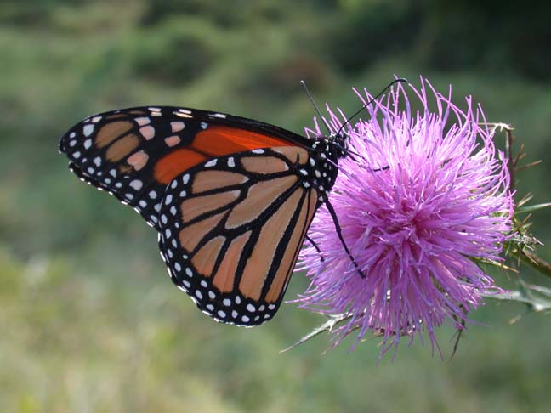
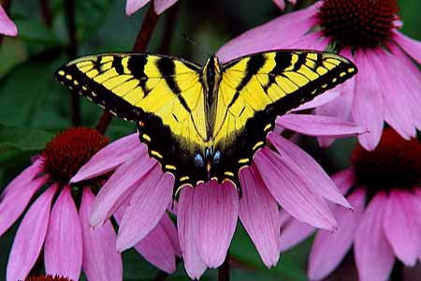
Butterflies

Slide 15
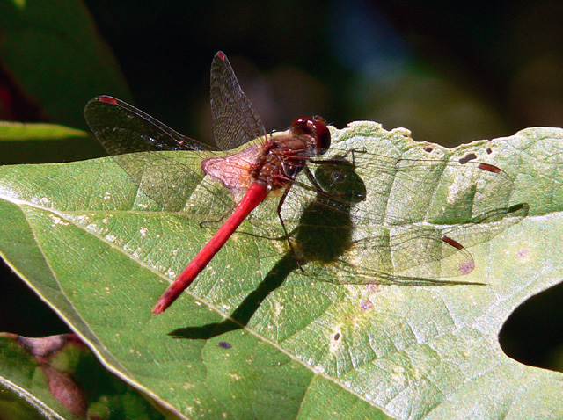
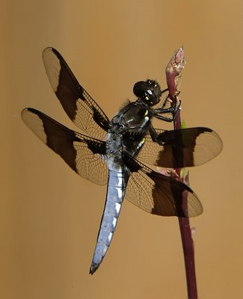
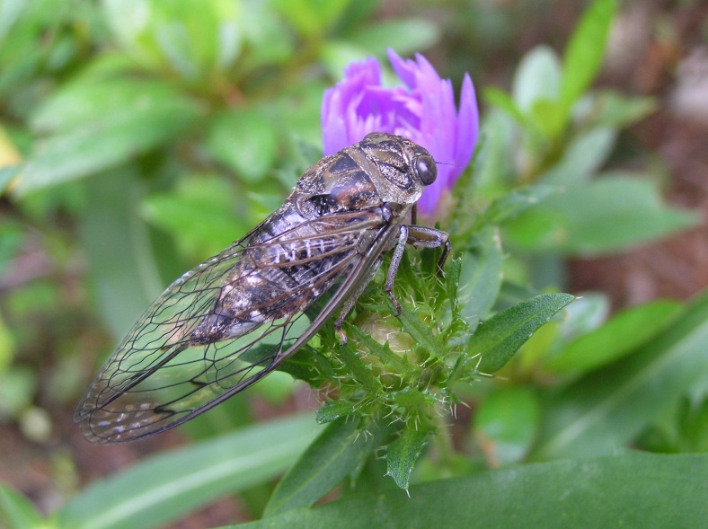
Dragonflies & Cicada

Slide 16
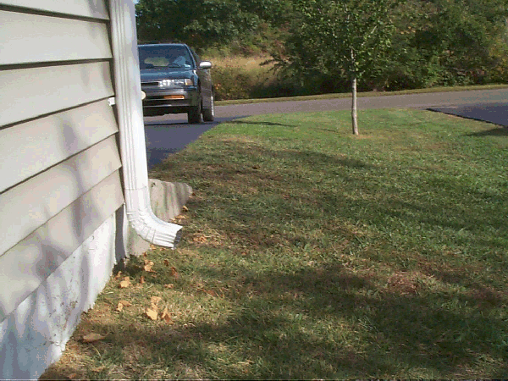
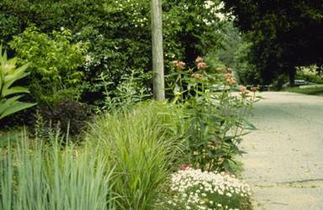
Building Your Rain Garden
Location:
Walk your property in the rain to see where it goes
Size of garden should be 1/4 - 1/3 of impervious area (e.g., 800 sq ft roof or driveway = 10’ x 20’ rain garden)
Do not build in places that do not drain well
Keep 10 feet from house foundation (or septic leach field)

Slide 17
Building Your Rain Garden
Depth and Soils:
Dig a shallow basin 12 - 18 inches deep for the garden
Rain garden soil must allow water to soak into ground
Soil mix = 50% sand, 30% compost and 20% topsoil
Mix will promote root growth + cleanse storm water
Plants:
One plant per 2 – 4 square feet (consider size of plant)
Place water loving species in deepest part of garden
Thin as plants grow, and/or replace as necessary
Notes:
Use a variety of plants in your rain garden and combine shrubs and flowers. Use a variety of species to see which ones work the best and choose plants that provide food for wildlife and attract butterflies. During the first year, weed monthly and get out the dandelions and other plants that will use up moisture. Water the garden if necessary during the first year and during dry spells. Prune the shrubs annually and replace mulch as needed.

Slide 18
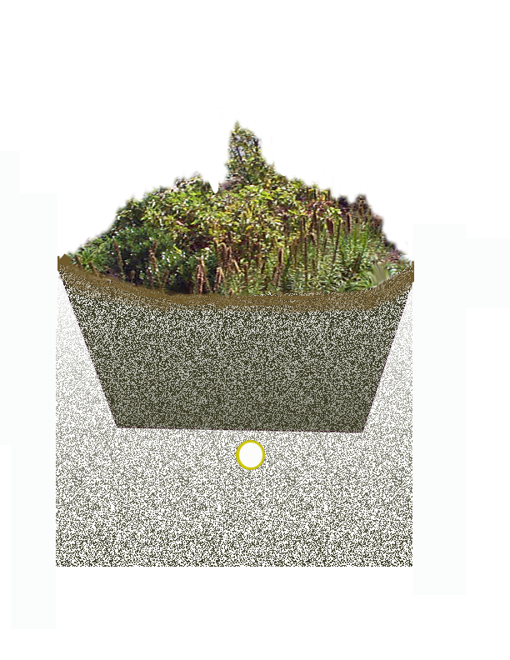
Profile of a rain garden
1) Plant materials
2) 3” wood mulch
3) 6-18” soil mix of 50% sand or stone aggregate, 30% organic leaf compost, and 20% topsoil
4) Underdrain where needed
Notes:
Bioretention areas, or rain gardens, are small landscaped areas designed to store and filter pollutants from runoff. They use a special mix of plants and soils selected for their pollutant removal efficiency and ability to survive under a wide range of conditions. The bioretention cell is the most cost effective strategy for cleaning and recharging storm water runoff.

Slide 19
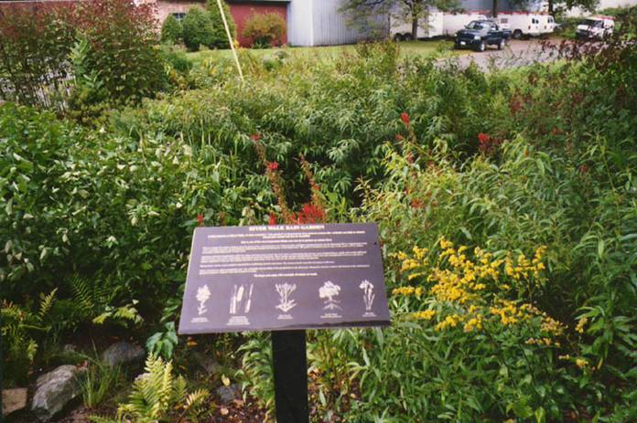
What to plant
Native species
Combine shrubs, wild flowers and grasses/sedges for a variety of benefits
Berry and nectar producers
Notes:
This is the same rain garden after a one year’s growth. Interpretive signage was used to give information about some of the plants.

Slide 20
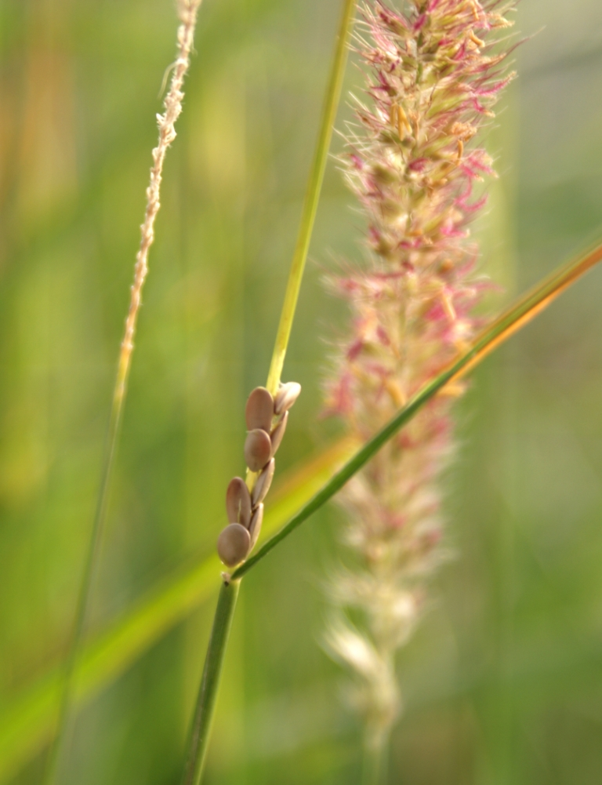
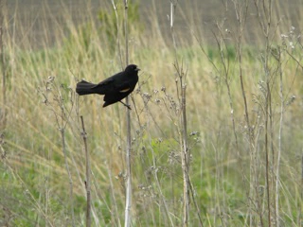
Wildlife Benefit
Pollinators
  Host for eggs/larvae
  Food for adults
Bird habitat (shelter and food)
  Shrubs (nesting), berries, seeds
Small mammals
Diversity is key

Slide 21
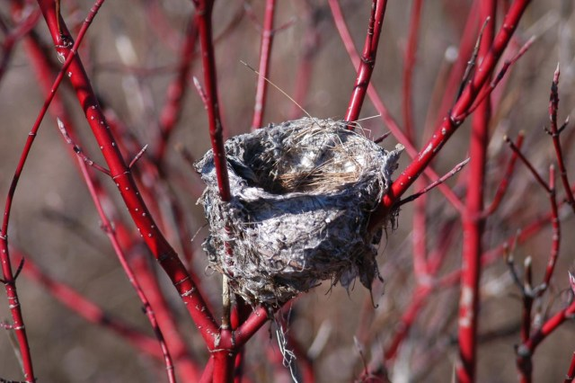
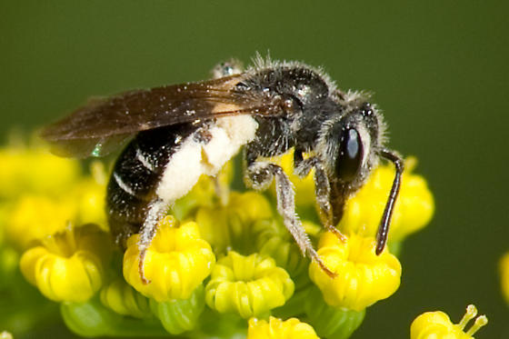
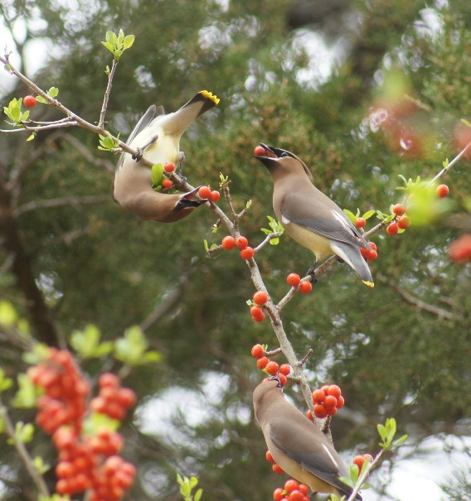
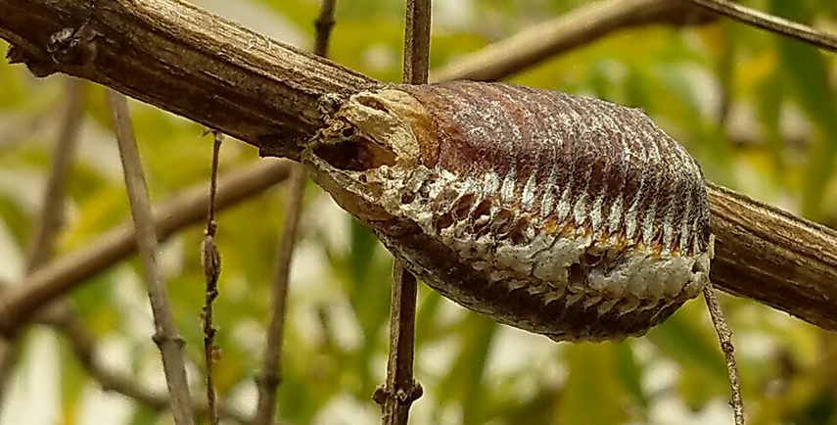
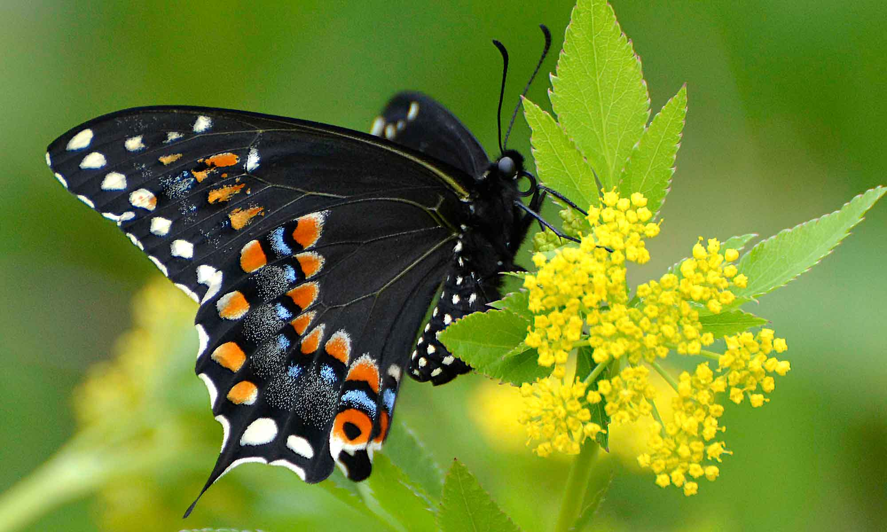
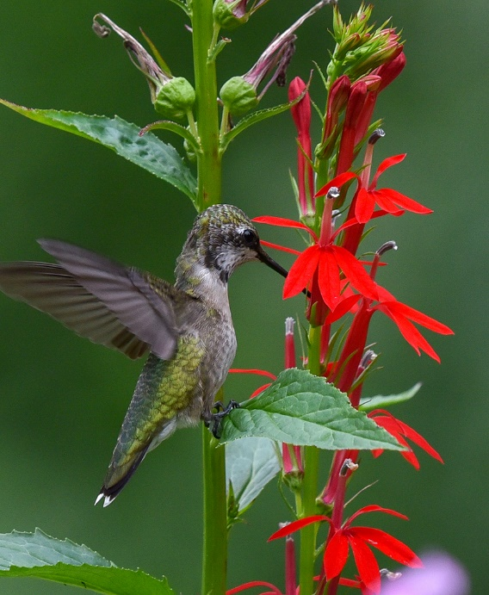
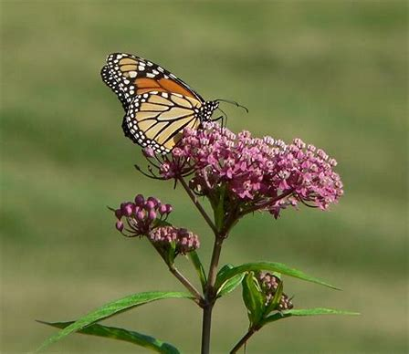
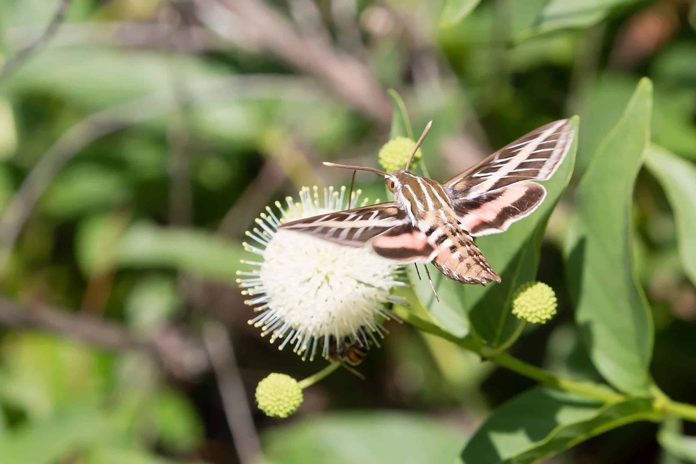
Wildlife
Benefit

Slide 22
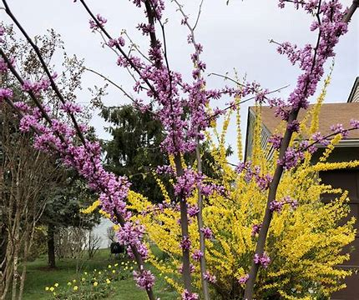
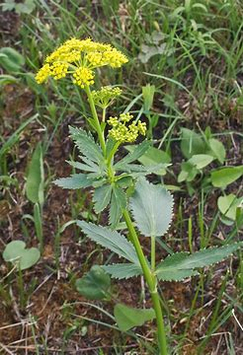
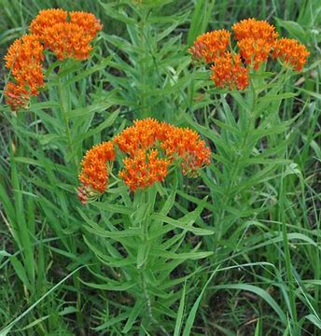
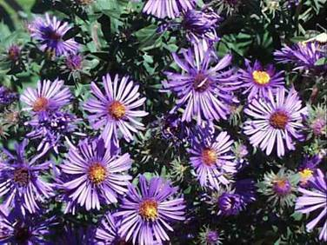
Bloom Period
Aim for blooming plants throughout the season
Eastern Redbud
March-May
Butterfly Milkweed
June-August
New England Aster
August-October
Golden Alexander
May-June

Slide 23
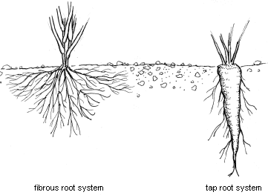
Plant Morphology
Root type
  Taproots create deep pores for drainage
  Fibrous roots create many small pores to help absorb stormwater
Perennial vs short-lived
Shrubs, herbs, and grasses/sedges
Diversity is key

Slide 24
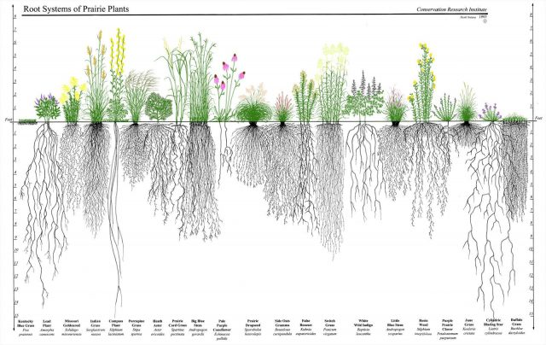
Root Type

Slide 25
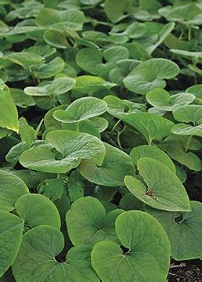
Shade/Sun Preference
Golden Alexander
Partial-Full Sun
Butterfly Milkweed
Full Sun
Canada Wild Ginger
Shade to Partial Sun

Slide 26
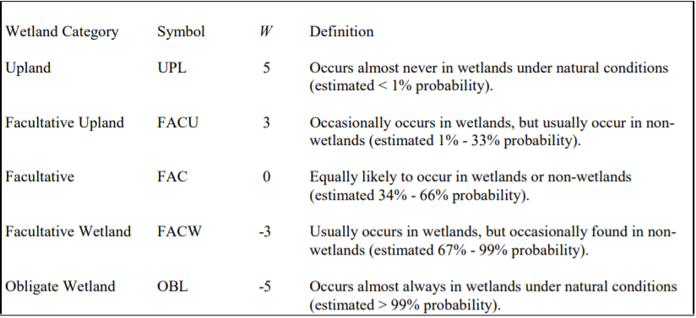
Flood/Drought Tolerance

Slide 27
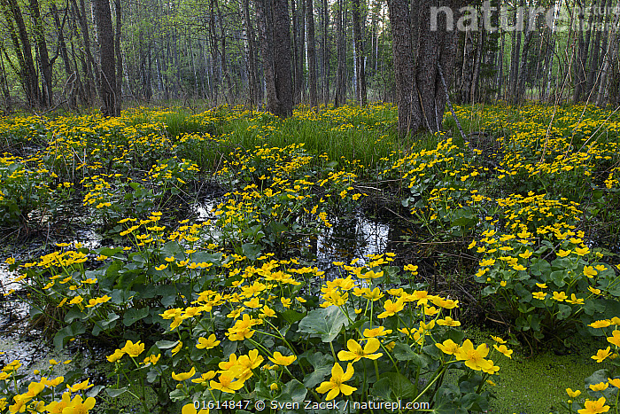
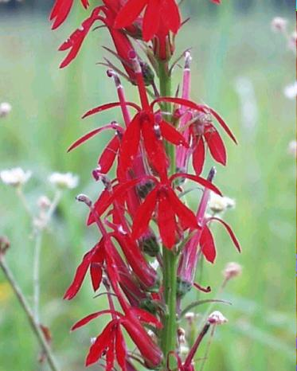
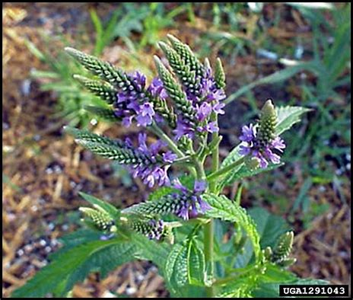
Flood/Drought Tolerance
Eastern Redbud
Facultative Upland (3)
Marsh Marigold, Cardinal Flower
Obligate Wetland (-5)
Golden Alexander
Facultative (0)
Blue Vervain
Facultative Wetland (-3)
Butterfly Milkweed
Obligate Upland (5)

Slide 28
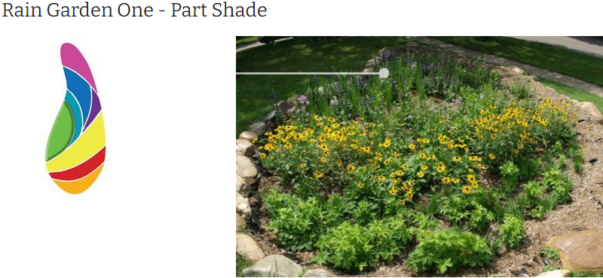
Example Garden Plan
https://www.washtenaw.org/710/Rain-Garden-One---Part-Shade

Slide 29

Example Garden Plan
Winterberry
Shade-Sun, Fac. Wet (-3)
Blooms May-July
Canada Wild Ginger
Shade, Upland (5),
Blooms April-May
Shade
Blue Vervain
Partial-Full Sun
Fac. Wet (-3)
June-Aug (4 wk Bloom)
Eastern Redbud
Shade-Partial Sun
Fac. Upland (3)
Blooms March-May
Swamp Milkweed
Full Sun, Wetland (-5)
Blooms June-Oct.
New England Aster
Full Sun, Fac. Wet (-3)
Blooms Aug-Oct.
Golden Alexander
Partial-Full Sun
Upland/Wetland (0)
Blooms May-June
Butterfly Milkweed
Full Sun, Upland (5),
Blooms Late June-Aug.
Sun

Slide 30
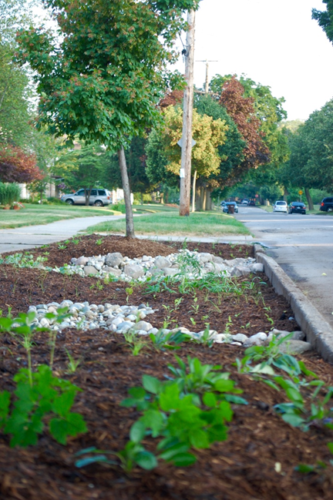

Rain Garden Maintenance: Why?
To help plants become better established (fill in)
Better establishment=
  Less future maintenance
  Better habitat for birds, pollinators etc
  Keeps gardens efficient at treating stormwater
Improves Aesthetic
  Can compete with function
Notes:
Less wordy, come up one at a time
It takes time for planting to become established
With proper care your planting can become full faster!
When planting is healthy and stones free from debris the rain garden is more efficient at treating stormwater
Better establishment of native plants in the first few years will lead to better function and less maintenance need in the future
Improves Aesthetic

Slide 31
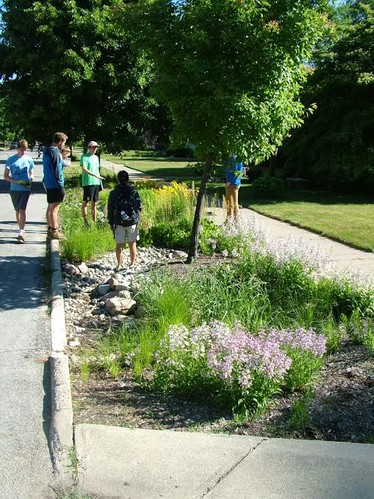
Ideally after a few years

Slide 32
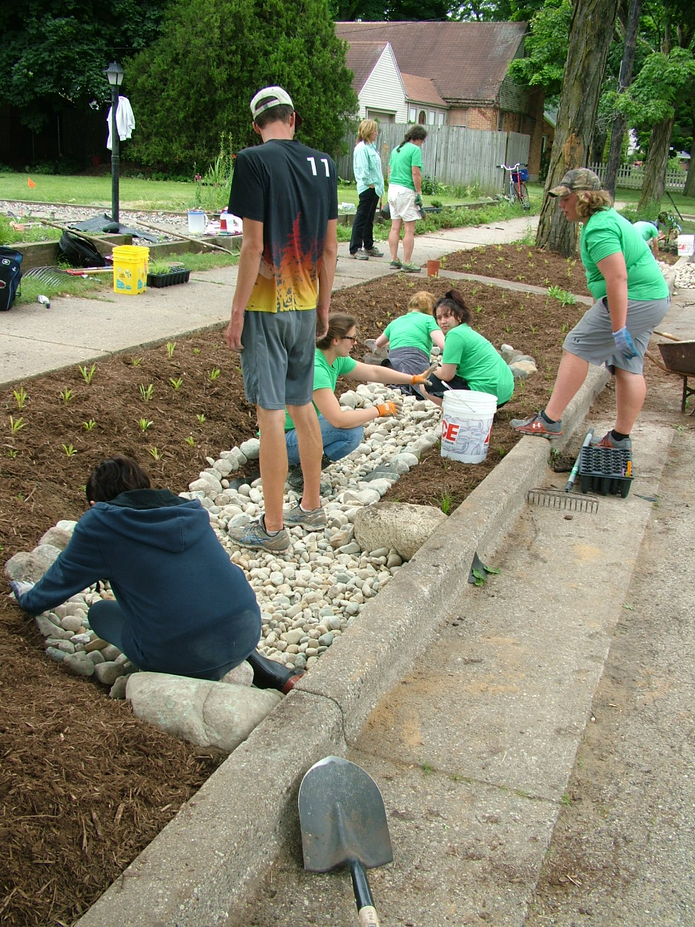
Rain Garden Maintenance
Weed Control
Pruning/thinning
Removing Sediment and Debris
Re-planting
Watering

Slide 33
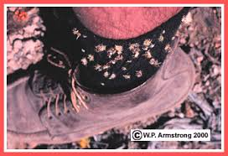

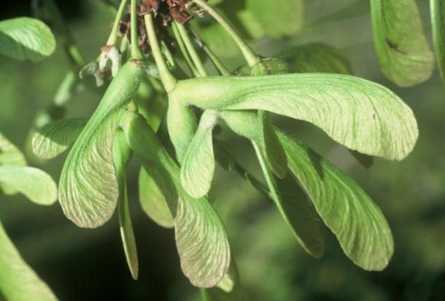
Weed Control: Limiting spread
Most important in first few years: Tip the balance towards native plants
Weed thoroughly once before mid-May, every few weeks after
If a weed has gone to seed, be careful how you dispose of it
  Good: Yard Waste Bag or Organicycle, Trash if these are not an option.
  Don’t leave dead weeds with seedheads sitting out or in an open compost pile (unless hot composting)
  Check your clothes

Slide 34
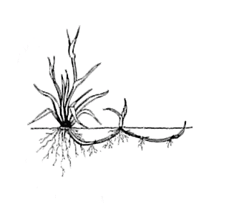


Weed Control: Pull the whole root
Taproot (Dandelion, Wild Carrot, Bull Thistle, Burdock, Garlic Mustard)
Fibrous (Clover, Plantain)
Rhizome (Nutsedge, Most invasive grasses)
*Easiest to get whole root after rain.
Notes:
Pulling is your best option
-use a shovel-weeding fork, weed after a rain.

Slide 35




Weed Control: Other methods
Mulching
Hand Cultivator, trowel, weeding fork
Spraying Herbicide
  Generally avoid spraying bc of impacts to insects and nearby native plants
Weed ID: http://www.msuturfweeds.net/id-tool/broadleaf/
Notes:
Mulching
About your aesthetic-don’t cover native seedlings if you want it to fill in.
Hand Cultivator
Works for small weeds
Spraying Herbicide
A few cautions
Dont spray good plants, be careful about run-off and drift (breeze)
Generally dont spray

Slide 36



Pruning/Thinning
Thin out those that are taking over
Move plants to fill in
Prune/maintain trees & shrubs
Remove dead plant material after following spring
Notes:
Thinning out
Ideally the garden will fill in so well that no bare soil or mulch will show. So thinning out is not necessary. But its up to how you want it to look: if a species is taking over, get rid of it. Or transplant some of it if you want. Just know that better function occurs with more full garden
Moving plants
Sometimes you may want shorter ones up front, or parts of the garden are fillling out better than others. Dont hesitate to move plants. Just make sure that you get all the roots, and water for a few days after transplanting. Best done right after rain (wet soil)
Pruning trees
Get rid of suckers. Trees are pretty resilient. The young tree pattern is how the tree will continue to look, so prune it accordingly. Also watch out for herbivory
Removing dead plant material
You can remove dead plant stalks if you think they are unsightly. But we encourage you to leave them bc...next slide

Slide 37


Benefits of leaving dead plant material
Benefits local biodiversity
  Bug and bird food and habitat
Spreads native seed
Can be beautiful through winter
Notes:
Mention stratification

Slide 38


Re-planting
Take note of where plants didn’t make it each year, fill in with new purchases or transplants from successful parts of garden to maintain cover
Notes:
Although we always recommend native plants, we are not legalistic about native over non-native plants. We just want to make sure that you are not spreading the weedier ornamentals throughout the watershed

Slide 39


Watering
Water new plants weekly, if no decent rain
Water older plants in dry spells
Watering never hurts if drainage is good
Pay attention to water stress
Consider a rain barrel
Increasing organic matter in soil (by adding compost during installation) helps garden absorb and maintain soil moisture

Slide 40



Sediment and debris removal
Remove leaves and sediment build-up to maintain stowmwater filtration capacity
Notes:
Sediment build-up means that your rain garden is working! That is all polluted sediment being kept from the stream. Put it in the trash.
We are working on better ways to remove sediment, any suggesions?
Keep leaves out of rocks to maintain porosity, but leave them in garden if you want, it replicates the natural environment and serves as a mulch cover.

Slide 41




WCCD technical assistance for landholders
  $40 Soil testing and soil amendment advice
  Technical assistance on rain garden planning, composting, pasture assessment, pollinator / wildlife habitat creation or assessment, invasive species control, cover crops
  Workshops and webinars on any of the above
Soil testing

Slide 42



Questions?
Contact Joel for technical assistance at: joel.betts@usda.gov
Contact Kathryn with questions about seedling sale at:
wccdplantsale@gmail.com
Call us at 508-829-4477 ext 5
Order plants online at: https://worcesterconservation.org/

